Slide 1
Product Design and manufacturing
Term-Project
Zero-screw
Project Team:
Azzan Almamari
Abdulrahman Almansori
Mohammed Alshibli

Slide 2


Outline:
Introduction
Opportunity Identifications
Customer needs
Target specification
Concept generation and concept selection
Management of projects
Conclusion

Slide 3
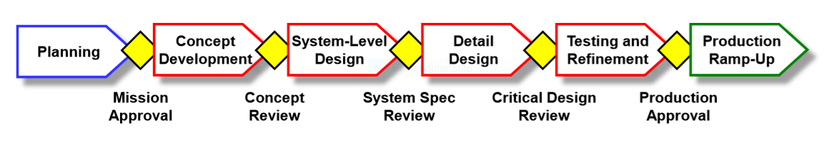
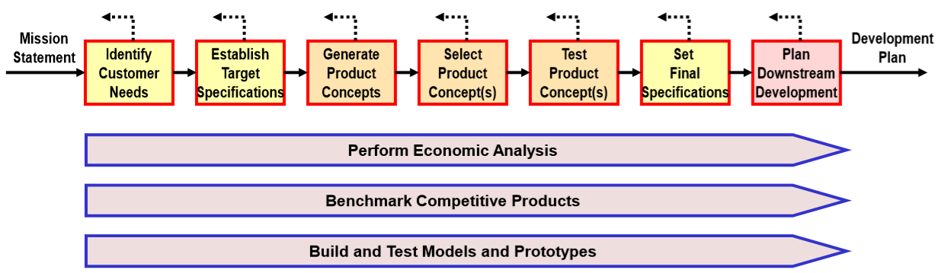
Introduction:

Slide 4
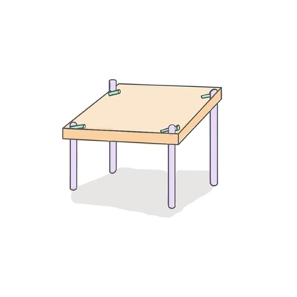
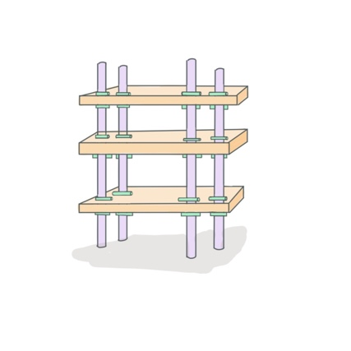
Opportunity Identification

Slide 5
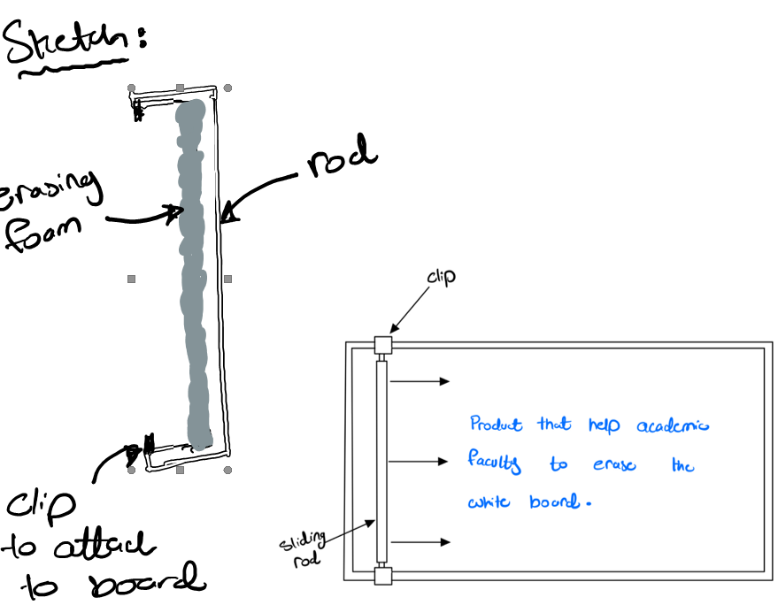
Opportunity Identification

Slide 6
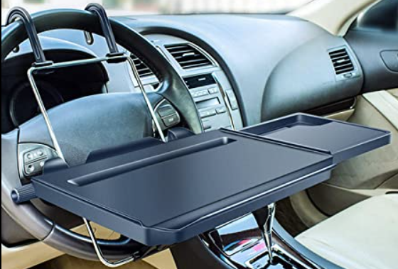
Opportunity Identification

Slide 7

Mission statement
Project Description:
Mission statement: Portable Car Table
Product Description | A Portable Foldable car table with a picnic function.
Benefit proposition | Ease in dining in the car. 2 in 1 table. (Dinning in the car and outside) Work comfortably in the car
Primary Market | Every Car owner who wishes to dine with ease in the car.
Secondary Market | Adventurers, hikers, and picnic lovers.
Assumptions and Constraints | Easy to install and remove. Good surface texture. Lightweight and small size.
Stakeholders | User Production Management Salesforce.

Slide 8
Customer needs:
“Good product (quality)”
The table is made of good material.
“I Can put it easily”
The table is easy to fix /install.
“I can carry it easy”
The table is portable.
“Not slippery”
The food grips on the table surface.
“The table is large enough”
The table has large surface area

Slide 9
Target specifications:
The volume of the table
Time to remove and install
The Table can be carried easily after usage directly.
The Table can be cleaned easily.
Surface area.

Slide 10
Sources of information through concept generation process
- Searching externally through:
a- Interview future customers
b- Search patents.
-Searching internally.

Slide 11
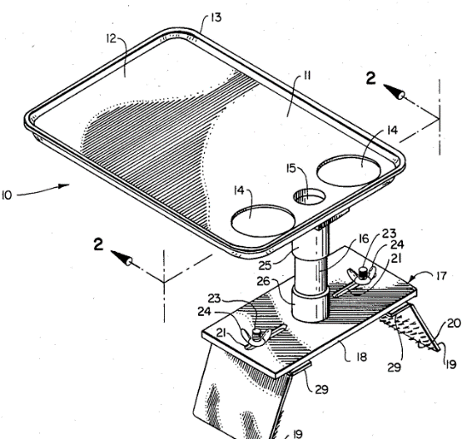
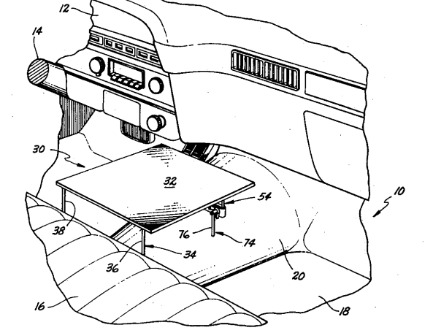
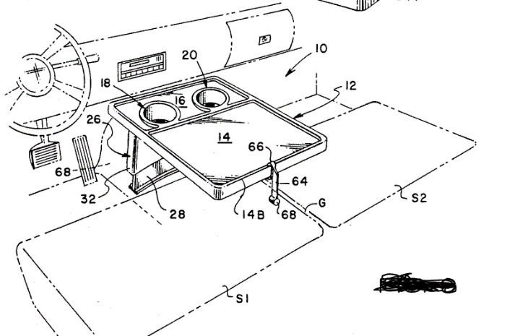
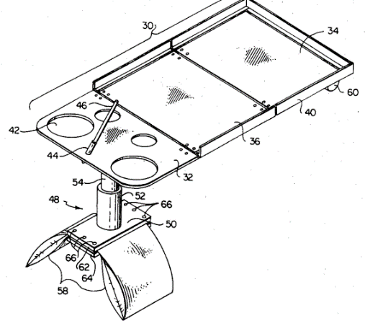
Patent Search:
Car Snack table
Detachable car seat tables
Adjustable car table
Car seat tables

Slide 12
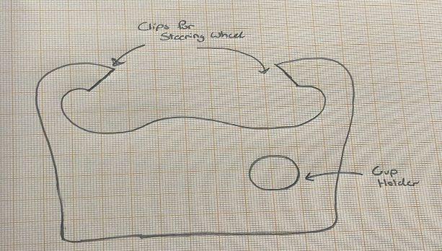
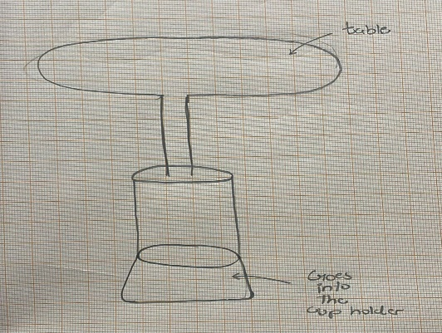
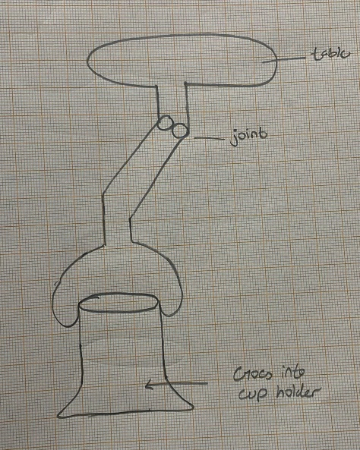
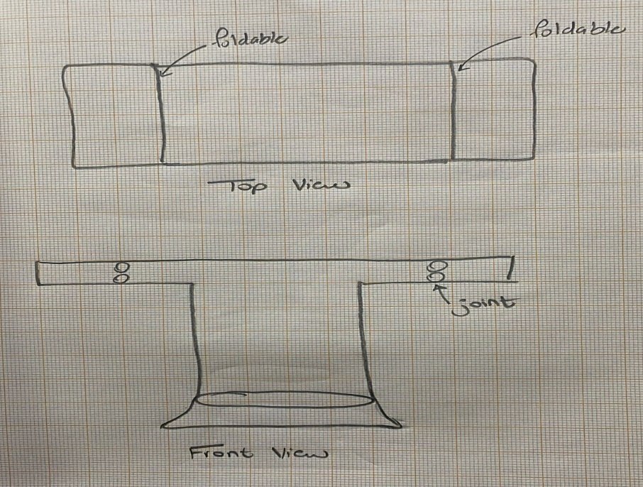
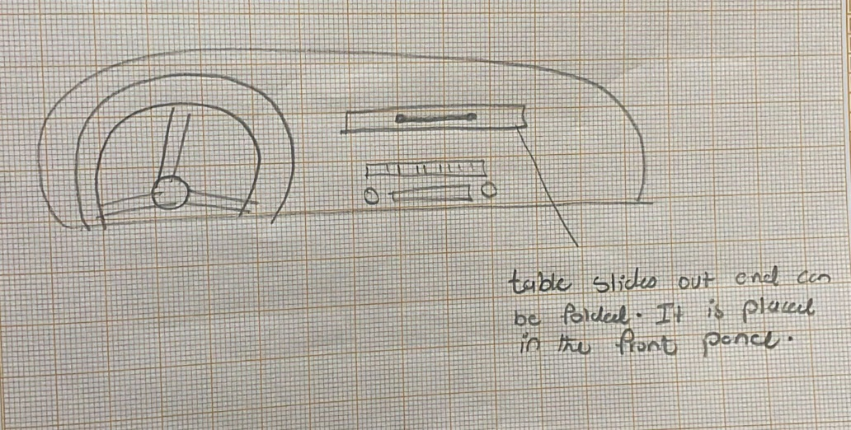
Concepts generated:
A
B
C
D
E

Slide 13
Concept screening:
 | A | B (Reference) | C | D | E
Cheap sell price | + | 0 | - | - | 0
Light Weight. | + | 0 | + | - | 0
Large surface area | - | 0 | 0 | + | +
smooth surface | - | 0 | + | + | +
good grip surface | - | 0 | + | + | -
Assemble/disassemble time | - | 0 | 0 | + | +
Durability | + | 0 | 0 | + | -
sum of + | 3 | 0 | 3 | 5 | 3
sum of 0 | 0 | 7 | 3 | 1 | 2
sum of - | 4 | 0 | 1 | 2 | 2
rank | 5 | 4 | 2 | 1 | 3

Slide 14
concept scoring:
 |  | C |  | D |  | E
 | weight | Rating | Weighted score | Rating | Weighted score | Rating | Weighted score
Cheap sell price | 20% | 3 | 0.6 | 3 | 0.6 | 3 | 0.6
Light Weight. | 10% | 2 | 0.2 | 2 | 0.2 | 4 | 0.4
Large surface area area | 30% | 2 | 0.6 | 5 | 1.5 | 4 | 1.2
smooth surface | 5% | 3 | 0.15 | 4 | 0.2 | 3 | 0.15
good grip surface | 10% | 3 | 0.3 | 4 | 0.4 | 2 | 0.2
Assemble/disassemble time | 10% | 3 | 0.3 | 4 | 0.4 | 2 | 0.2
Durability | 15% | 3 | 0.45 | 2 | 0.3 | 1 | 0.15
Total score |  | 2.15 |  | 3.6 |  | 2.9
rank |  | 3 |  | 1 |  | 2

Slide 15
Best Concept
D

Slide 16



Management of projects

Slide 17
Project: Duration
Managing Project Scope
Make it easier for the customer to identify it
Pipeline Critical Tasks
Breaking down main problem into subproblem
Priority for Critical Tasks
Identify it in early stages solve it fast when it arise

Slide 18
Project: Execution
Coordination
Avoid deviation from target
Clarifying each stage for all members
Assessing Project Status
Knowing about project progress
Project executed as planned for
Corrective Actions
When there is a deviation from target
Return back to track

Slide 19
Project: Evaluation
Checking on Project Progress
Ensure that what you're trying to develop is meeting with customer needs.
Identifying strengthen and weakness points
Check on project resources (money, time, work power…etc.)
Share the project progress with all members.

Slide 20
DFM (Design for Manufacturing)
The design has less number of parts.
The material will be used are wood, plastic and aluminum.
Appropriate assembly operations are mechanical and welding assembly.

Slide 21
the Process time:
Process Critical Path
Opportunity identification
2 weeks
Identify need statement
2 weeks
Product specification
1 week
Concept generation
2 weeks
Concept selection
1 week
Management
1 week
Final Report
1 week

Slide 22
Management of Projects:
PERT chart
Looking for opportunities to pursue.
Choosing the best opportunity to go with.
Gathering customer statements from one survey and interviews.
Change customer statements to customer need statements.
Generate target specifications.
Patent search
Generate concepts.
Select the best concept.
Design for manufacturing
Management of the project
Product development Economics
Final report
1
One week
One week
2
One week
3
4
One week
One week
5
6
One week
Two weeks
7
8
One weeks
9
10
11
Total time: 10 weeks and 2 days
3 days
3 days
3 days
12

Slide 23
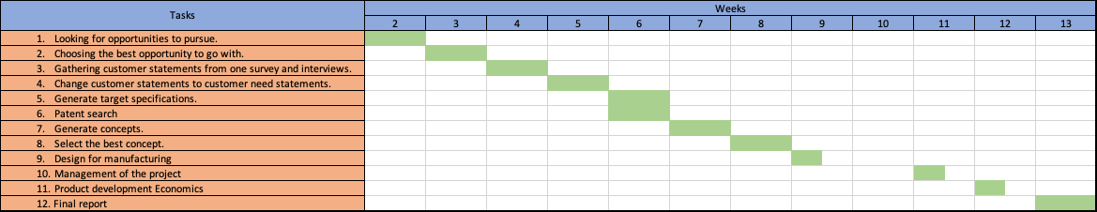
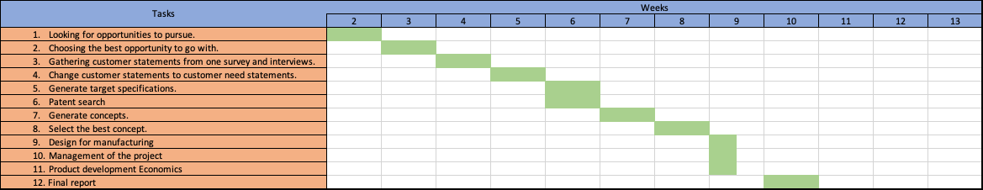
Management of Projects:
Gantt chart

Slide 24
Product Development Economics
 | first | last | burn rate
Development | 1 | 2 | -4000
Testing | 2 | 3 | -2000
Tooling and Ramp-Up Costs | 3 | 4 | -12500
Market Introduction | 3 | 4 | -3000
Ongoing Marketing Costs | 3 | 10 | -2000
Unit Sales | 3 | 10 | 2000
Unit Price | 3 | 10 | 7.000
Unit Production Cost | 3 | 10 | 3.000
Discount Rate (per time period) |  | 1.75%

Slide 25
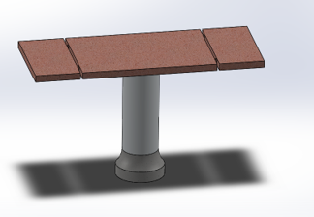
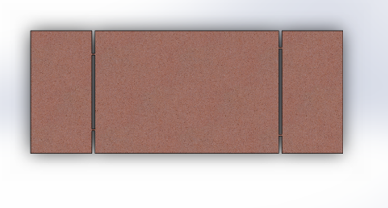
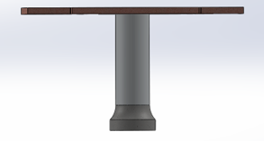
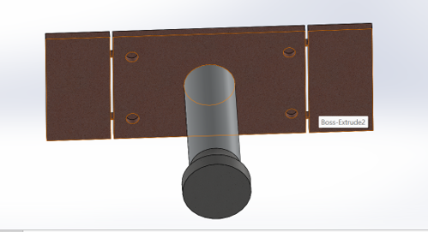
Technical Prototype

Slide 26
Conclusion
Importance of the project.
Difficulties faced in the project.
Future improvements.

Slide 27

Thank you
Any Questions?

